Slide 1
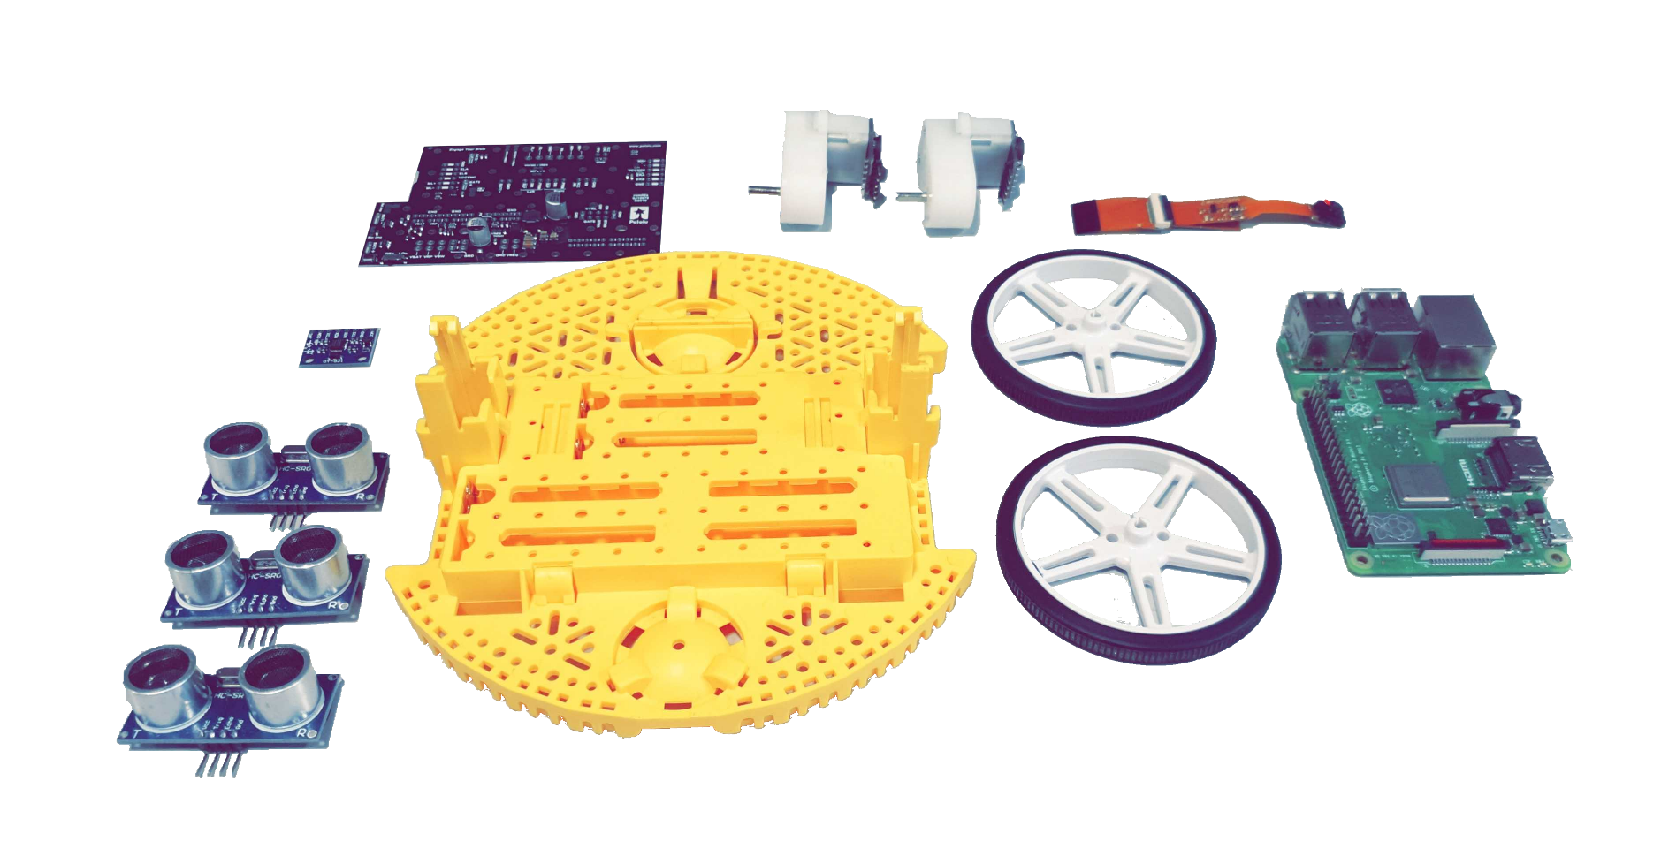
Co-operative Robotics Using Environmental Sensors Peter De Jonckheere, R David Dunphy, Andrew Fagan, Matthew Gaffney, Kyle Miller
This project aims to develop co-operative robotic systems which can effectively map and search a maze-like environment. Each agent is able to solve this task individually; however, the introduction of additional robots results in improved performance and a more robust system.
Context
Components
Co-operative robotics can be used to solve a variety of tasks more efficiently. Using multiple robots also introduces redundancy which is advantageous over single robot systems, especially in hazardous environments.
Previous work in co-operative robotics predominantly involves either centralised control or the use of extensive communication between agents, where as this project artificially restricts communication between robots to line-of-sight. This simulates environments with limited communication, such as subterranean exploration. This adds additional complexities in co-ordination as not all knowledge is shared.
The maze environment is used to test the robots’ ability to co-operate, whilst also demonstrating a potential use case of co-operative robotics.
Following research, the following components were chosen:
Pre-built Pololu Romi chassis kit:
Chassis and Wheels
120:1 Geared Motors
Hall-effect Quadrature Encoders
Pololu Motor Driver and Power Distribution Board
Raspberry Pi 3B+
Pi Camera
HC-SR04 Ultrasonic Sensors
MPU-6050 6-DOF Inertial Measurement Unit
These were integrated together using a bespoke Printed Circuit Board (PCB).
Aims/Objectives
Design and construct a two-wheeled differential drive robot
Develop a sensor system to allow the robot to perceive its locale
Implement a Simultaneous Localisation and Mapping (SLAM) algorithm to allow the robot to explore its environment
Develop a system to allow robots to communicate and co-operate
Develop a test environment to evaluate the system’s performance
Add additional robots and evaluate scalability of the approach
Figure 1: Unassembled components
Outcomes
Three homogeneous differential drive robots:
Bespoke PCB design
Robust and configurable mechanical design
Robotic Operating System (ROS) architecture with modular and customisable software design
Scalable multi-agent communication system
Computer Vision object detection system
Differential Drive Control system
Odometry and sensor fusion systems
ROS SLAM implementation
Modular testing environment
Challenges
Determining line-of-sight for communication
Tuning a PID feedback loop for the motors
Implementing a sensor fusion system to combine each sensor’s reading
Identifying moving objects (other robots) in SLAM maps
Performing loop closure in maps between two robots

Slide 2
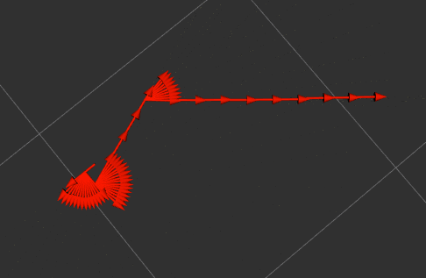
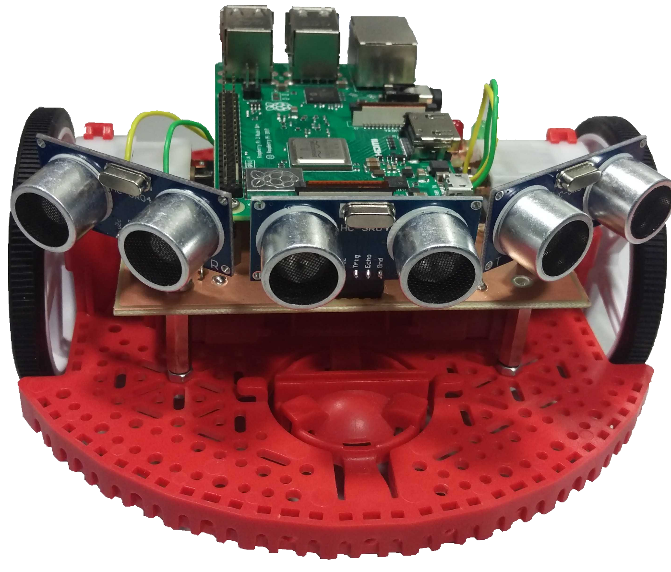
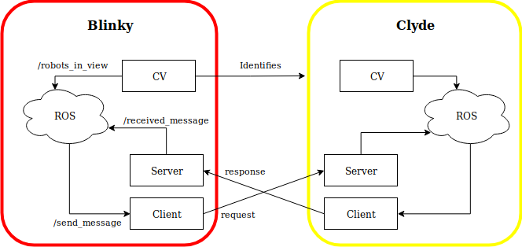
Co-operative Robotics Using Environmental Sensors Peter De Jonckheere, R David Dunphy, Andrew Fagan, Matthew Gaffney, Kyle Miller
bot
SLAM
Software
The Robot Operating System (ROS) was used as the main framework for software development. It is open-source and used for complex modular robotic networks. ROS is a collection of libraries and tools to develop modules within a robot. It is designed to be as distributed and modular as possible. As a result, ROS allows different modules to be programmed in different programming languages.
ROS operates a topic-based publish-subscribe model, in which each component of the robot is represented by a node. Events are triggered by nodes publishing any received data to topics. This form of event-driven implicit invocation allows for highly modular and decoupled design.
ROS also solves the problem of being able to describe the robot in a machine readable way. It provides a set of tools for describing and modelling the robot using URDF, an XML document
containing the physical characteristics of the
robot.
Simultaneous Localisation And Mapping
Allows the robot to:
build a map of the environment
know its location within the map
Used for exploring environments where prior knowledge of a map cannot be relied upon
Relies on odometry obtained from sensor fusion algorithms
Multiple algorithms researched and available for ROS integration
Implemented using the Gmapping and Robot_localization packages
Gmapping uses the particle filter approach, a probabilistic method for implementing SLAM
Figure 2: Example path of robot
Co-operation
AI
Uses a Peer to Peer Wireless Ad-hoc Network (WANET)
Artificially restricted to line of sight
Other robots identified using computer vision
Co-operation only initiated when computer vision identifies a robot successfully
The artificial intelligence control module is used by the robot to solve the maze using its map of the environment. Given a SLAM-generated map and a set of available actions, the AI API will allow the agent to be programmed using normal AI techniques such as those used in games.
For example, a modified depth-first search algorithm can be used to attempt to solve the maze by exploring each path in turn as if it were a node on a tree.
This will allow a single robot to search the maze, and by making co-operative decisions on path selection multiple robots can search the maze more efficiently. By sharing the maps between robots and co-operating to decide on best exploration paths, the maze searching algorithm can be improved.
Figure 3: Comms modules for Blinky sending to Clyde
Using the Python Socket library
Multi-threaded thread-safe implementation
Effectively unlimited message queue size
JSON objects used to send and receive information
Stress-tested for scalability

Slide 3
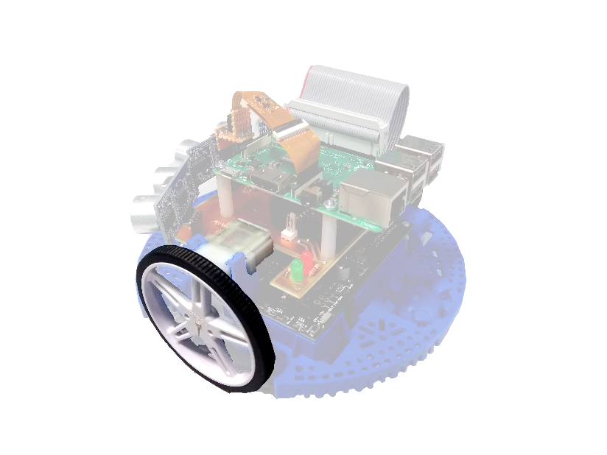
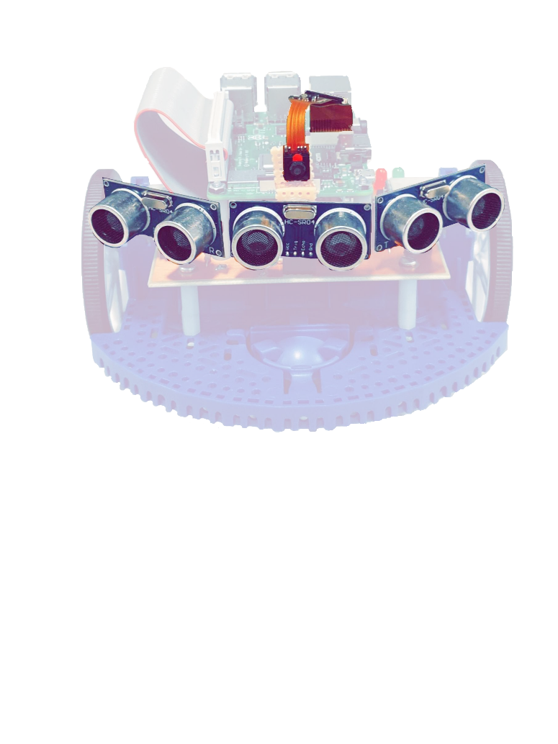
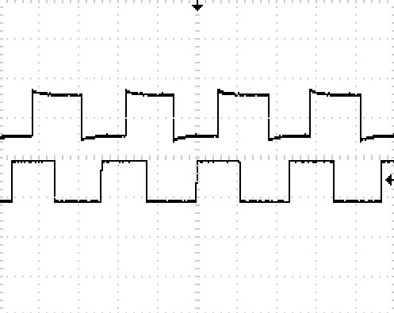
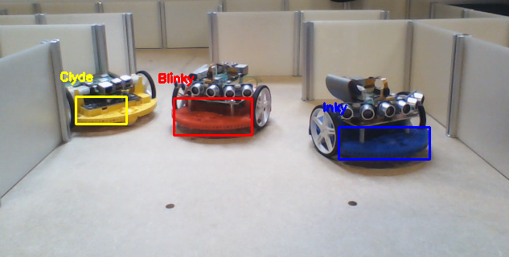
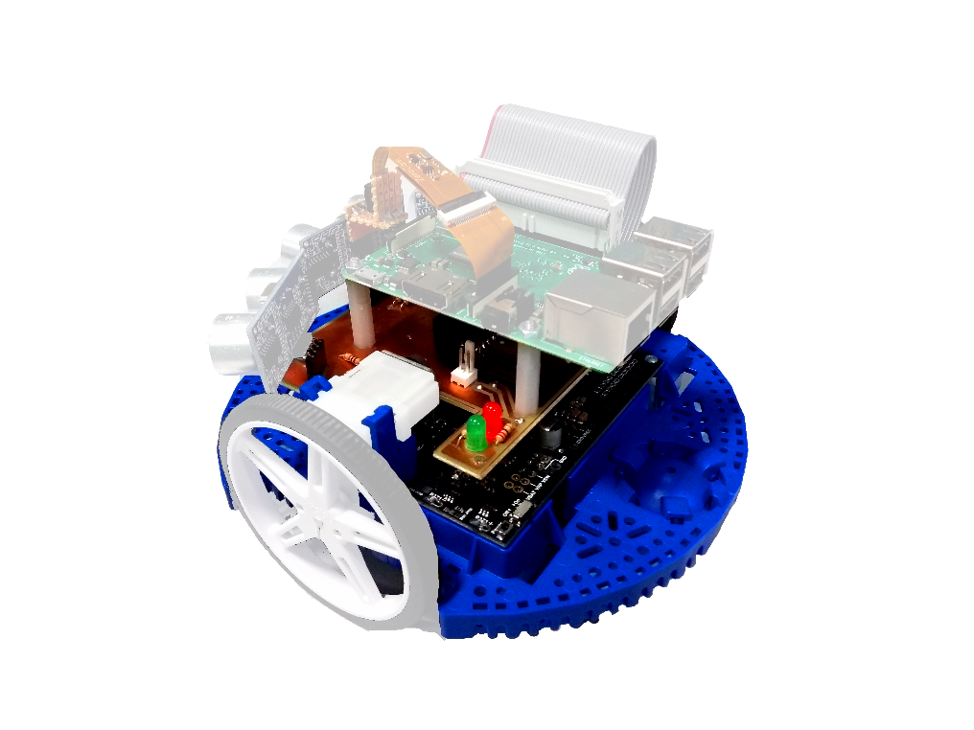
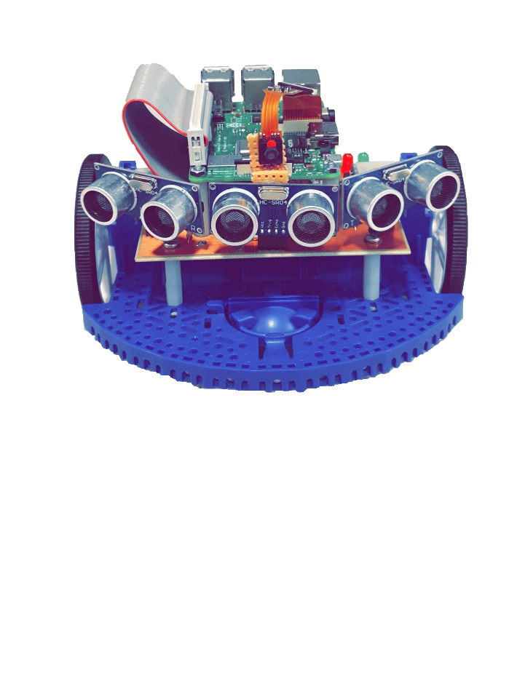
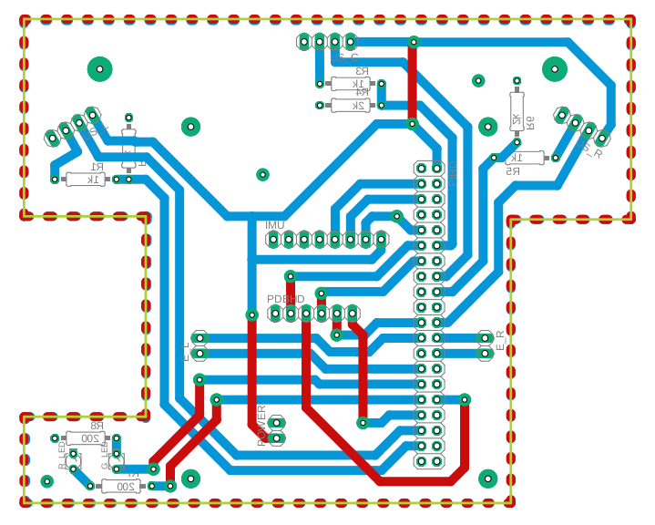
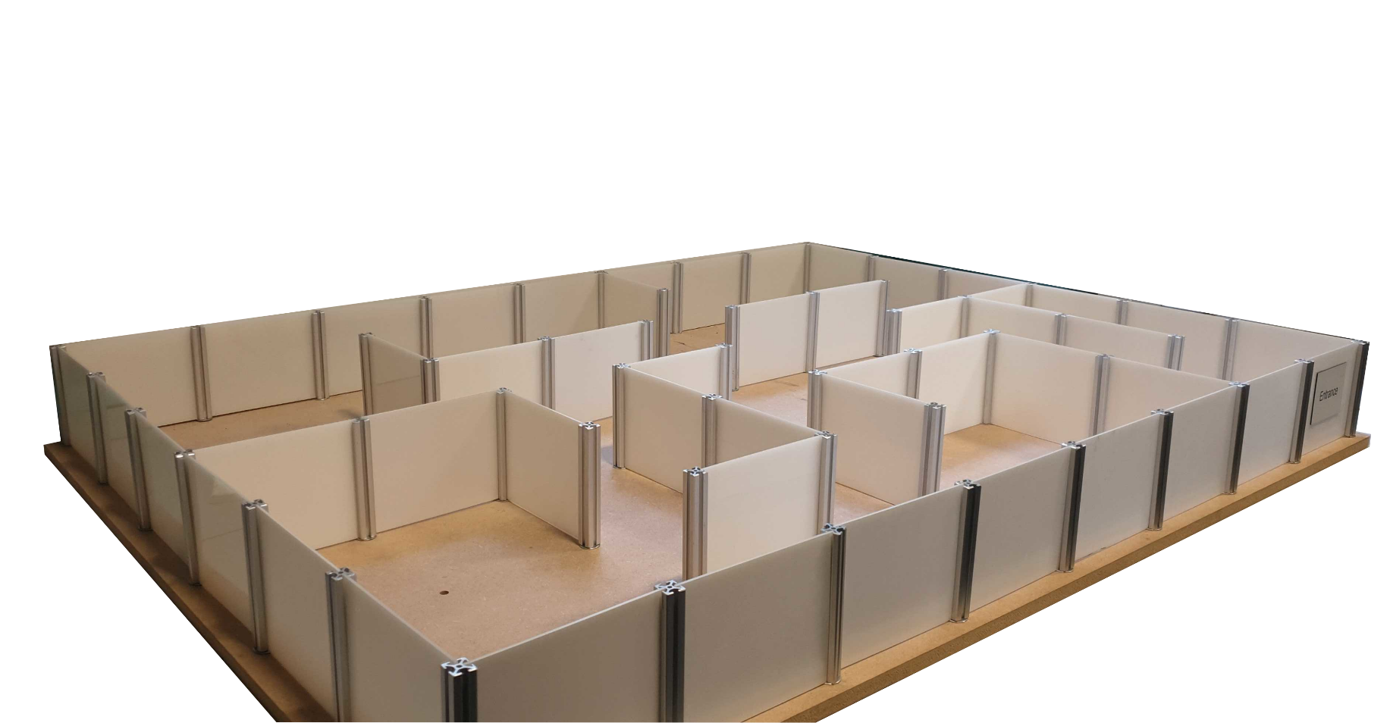
Co-operative Robotics Using Environmental Sensors Peter De Jonckheere, R David Dunphy, Andrew Fagan, Matthew Gaffney, Kyle Miller
Odometry
Exteroceptive Sensors
Two quadrature encoders and an Inertial Measurement Unit (IMU) are used to obtain the odometry data. These were both tested in isolation before integration into the system. The IMU provides linear
Ultrasonic sensors and a Pi camera for computer vision
Ultrasonic transducers operate by measuring flight time of reflected acoustic signals
The sensors have a 30° cone of detection so 3 were used for a 90° cone of detection overall
Each sensor’s feedback goes to SLAM node
Figure 4: Encoder Waveform
acceleration and angular velocity readings and these measurements are used to aid the localisation, whilst the encoder feedback is used by the PID controller.
The Differential Drive (DDR) System uses Proportional-Integral-Derivative (PID) rate controllers for independent wheel speed control. The PID was tuned using the Ziegler-Nichols method.
The sensor data is combined using an Extended Kalman Filter (EKF). This takes in the readings and calculates an estimated state change based on the probability of error of each sensor.
Figure 5: Identification of robots with Computer Vision
Computer vision using the Pi Camera and OpenCV
Object detection used to identify other robots
Construction
Testing
A PCB was designed to integrate the odometry and exteroceptive sensors together with the Raspberry Pi 3. The IMU was positioned as close to the centre of rotation as possible so as to minimise interference from centripetal forces. Also, the ultrasonic sensors had to be positioned at the correct angles whilst also integrating with the power distribution board.
Extensive unit testing has taken place for each subsystem prior to integration to limit potential system issues.
Robots were tested using a bespoke modular maze environment. The maze was constructed in conjunction with the mechanical workshop to our design specification. Different maze configurations were used to test the performance of the robots, both individually and collectively.
Figure 6: Final PCB Design
The camera was fixed securely to a mount above the central ultrasonic sensor in order to maximise the field of view.
Figure 7: Complex Maze Configuration

